Slide 1

Pg_largeobject, when vacuum is not enough
PostgreSQL Database Conference Belgium
Priyanka Chatterjee
Schwarz IT KG - STACKIT

Slide 2



Priyanka Chatterjee
PostgreSQL Database Conference Belgium
Database Engineer (2014 - present)
Worked in past in companies like Adjust, Groupon, AWS, Subex
Currently working for the Postgres Database Product team at STACKIT (Cloud provider from the Schwarz Group)
Let‘s connect!
2
2
Notes:
Ich bin übrigens Maximilane Musterfrau, ich bin…

Slide 3

Agenda
PostgreSQL Database Conference Belgium
01 What is a large object
02 Largeobject features in PostgreSQL
03 Large object functions
04 Vaccumlo
05 Demo
06 What happens when you run vacuumlo
07 Lo module

Slide 4
What is a large object?
A large object(LOB) is a data type that is used to store large amount of data.
Typically this data is too large to be stored in a regular row of a database table
BLOB: Binary large object, eg: images, videos, etc
CLOB: Character large object, eg: text documents or xml files

Slide 5
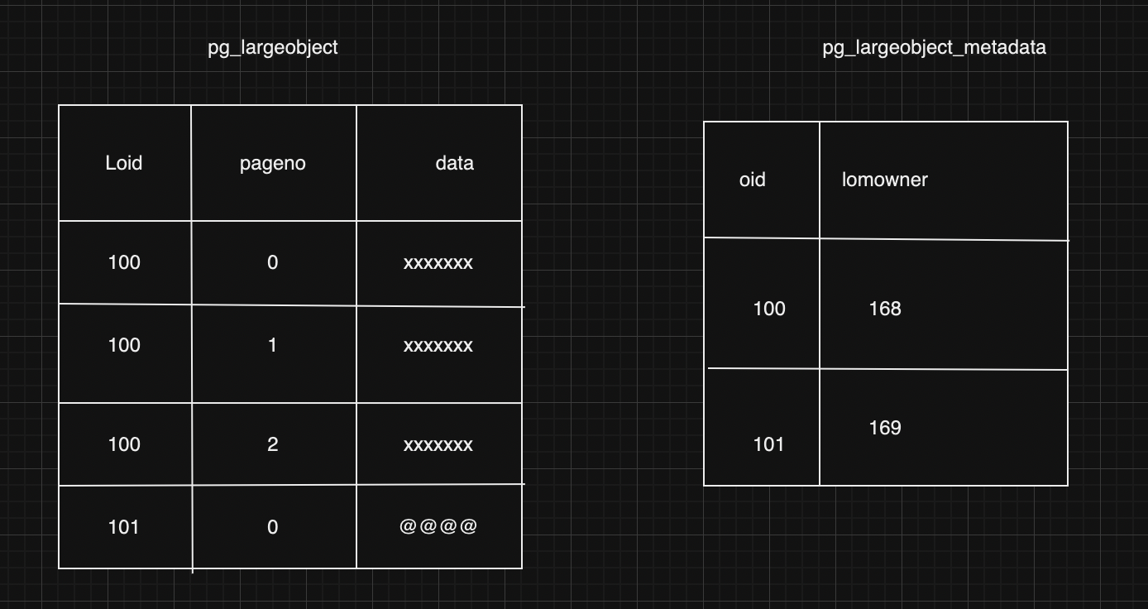
Postgres features for large objects
1. pg_largeobject and pg_largeobject_metadata

Slide 6
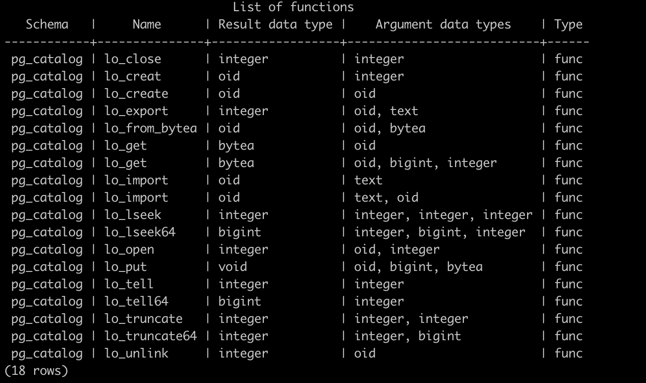
Large Object function

Slide 7
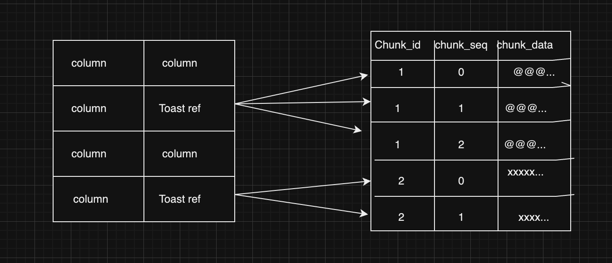
2. TOAST: The oversized attribute storage technique (text, varchar, bytea, numeric)

Slide 8

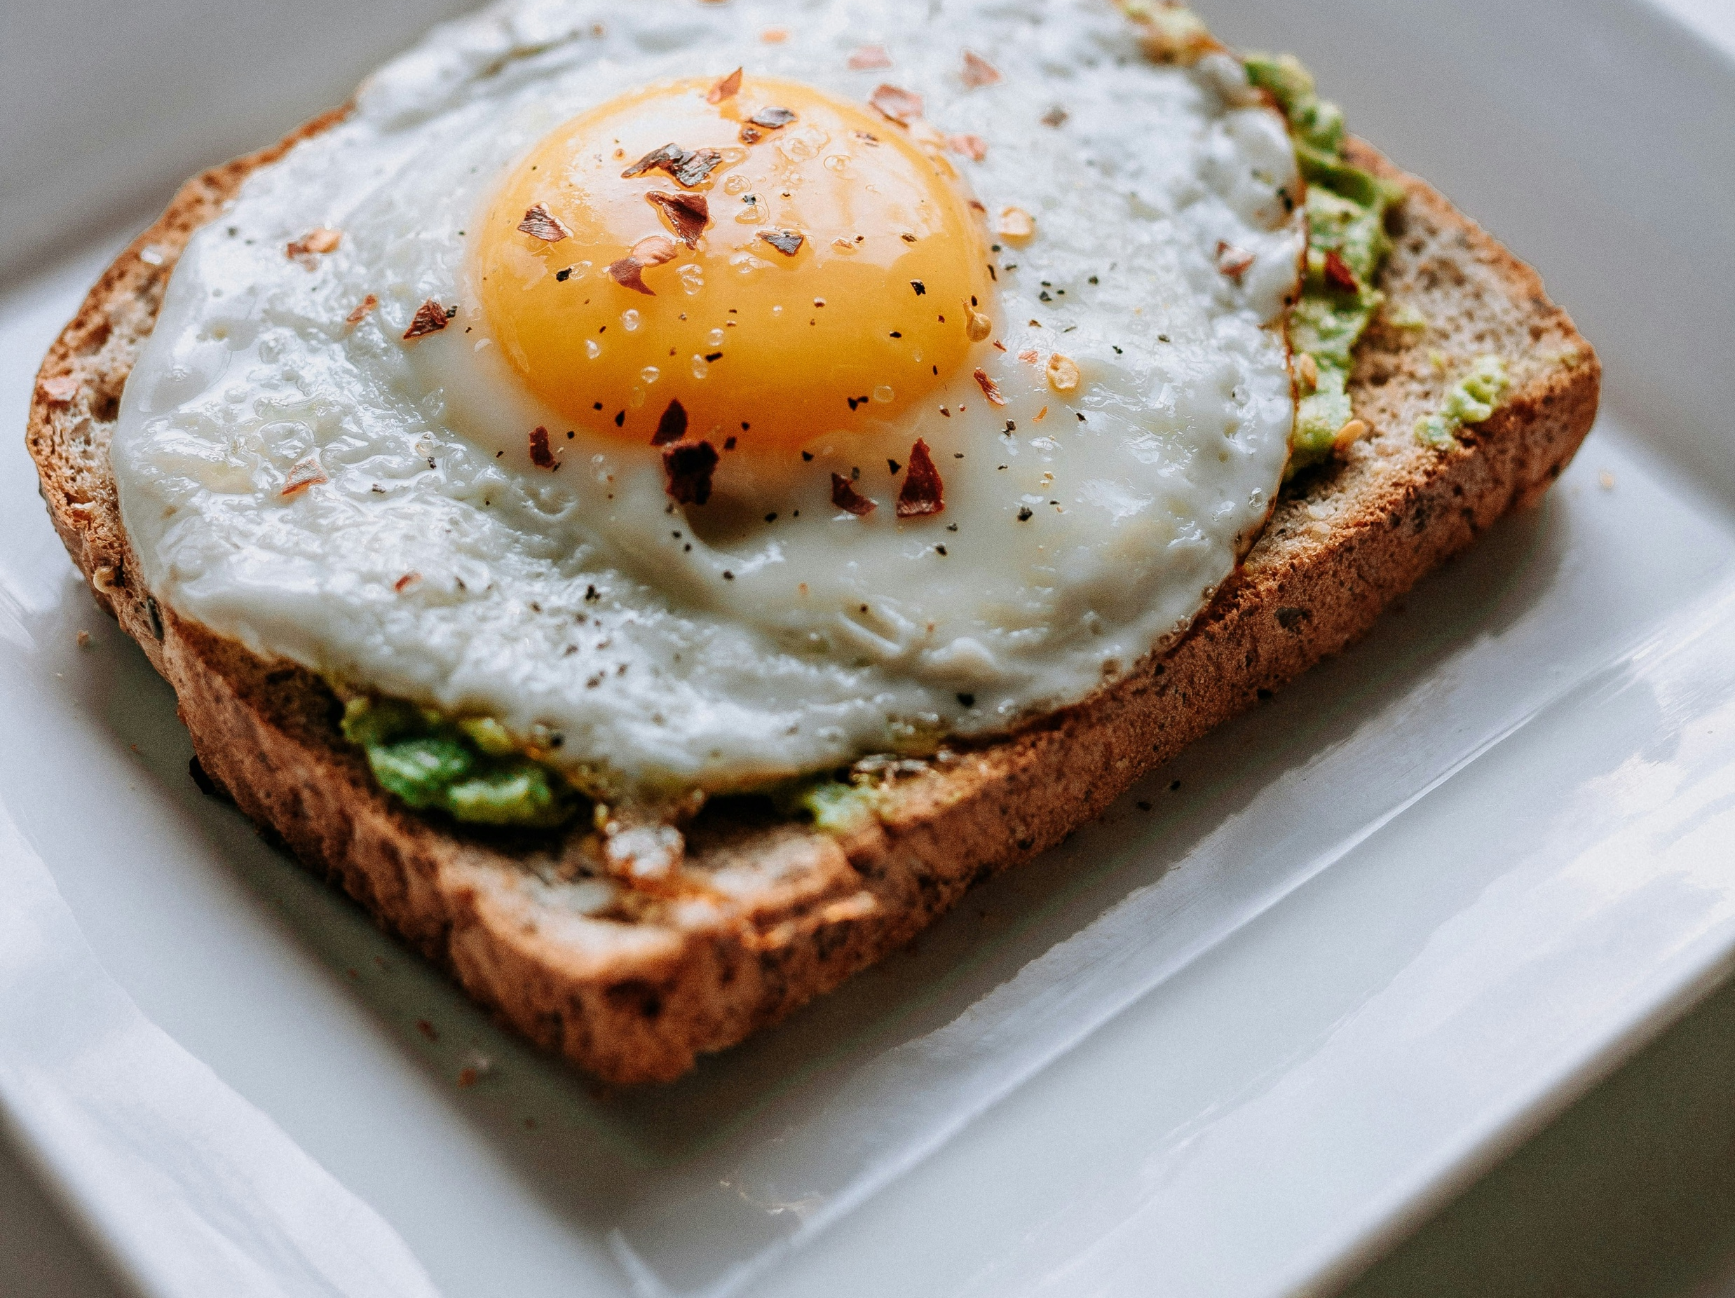
How to select between Toast and pg_largeobject?
Easy for User Need to work with special functions
Max data size 1GB Max data size 4TB
No partial data retrieval Partial and streaming style data retrieval
Regular vacuum Vacuum might not be enough
DEPENDS!

Slide 9
Vacuumlo
is a simple utility program that will remove any “orphaned” large objects from a PostgreSQL database
client application in contrib
can be run from anywhere, independent of where the database server resides
vacuumlo [option...] dbname

Slide 10

Size: 2.542.654 bytes

Slide 11
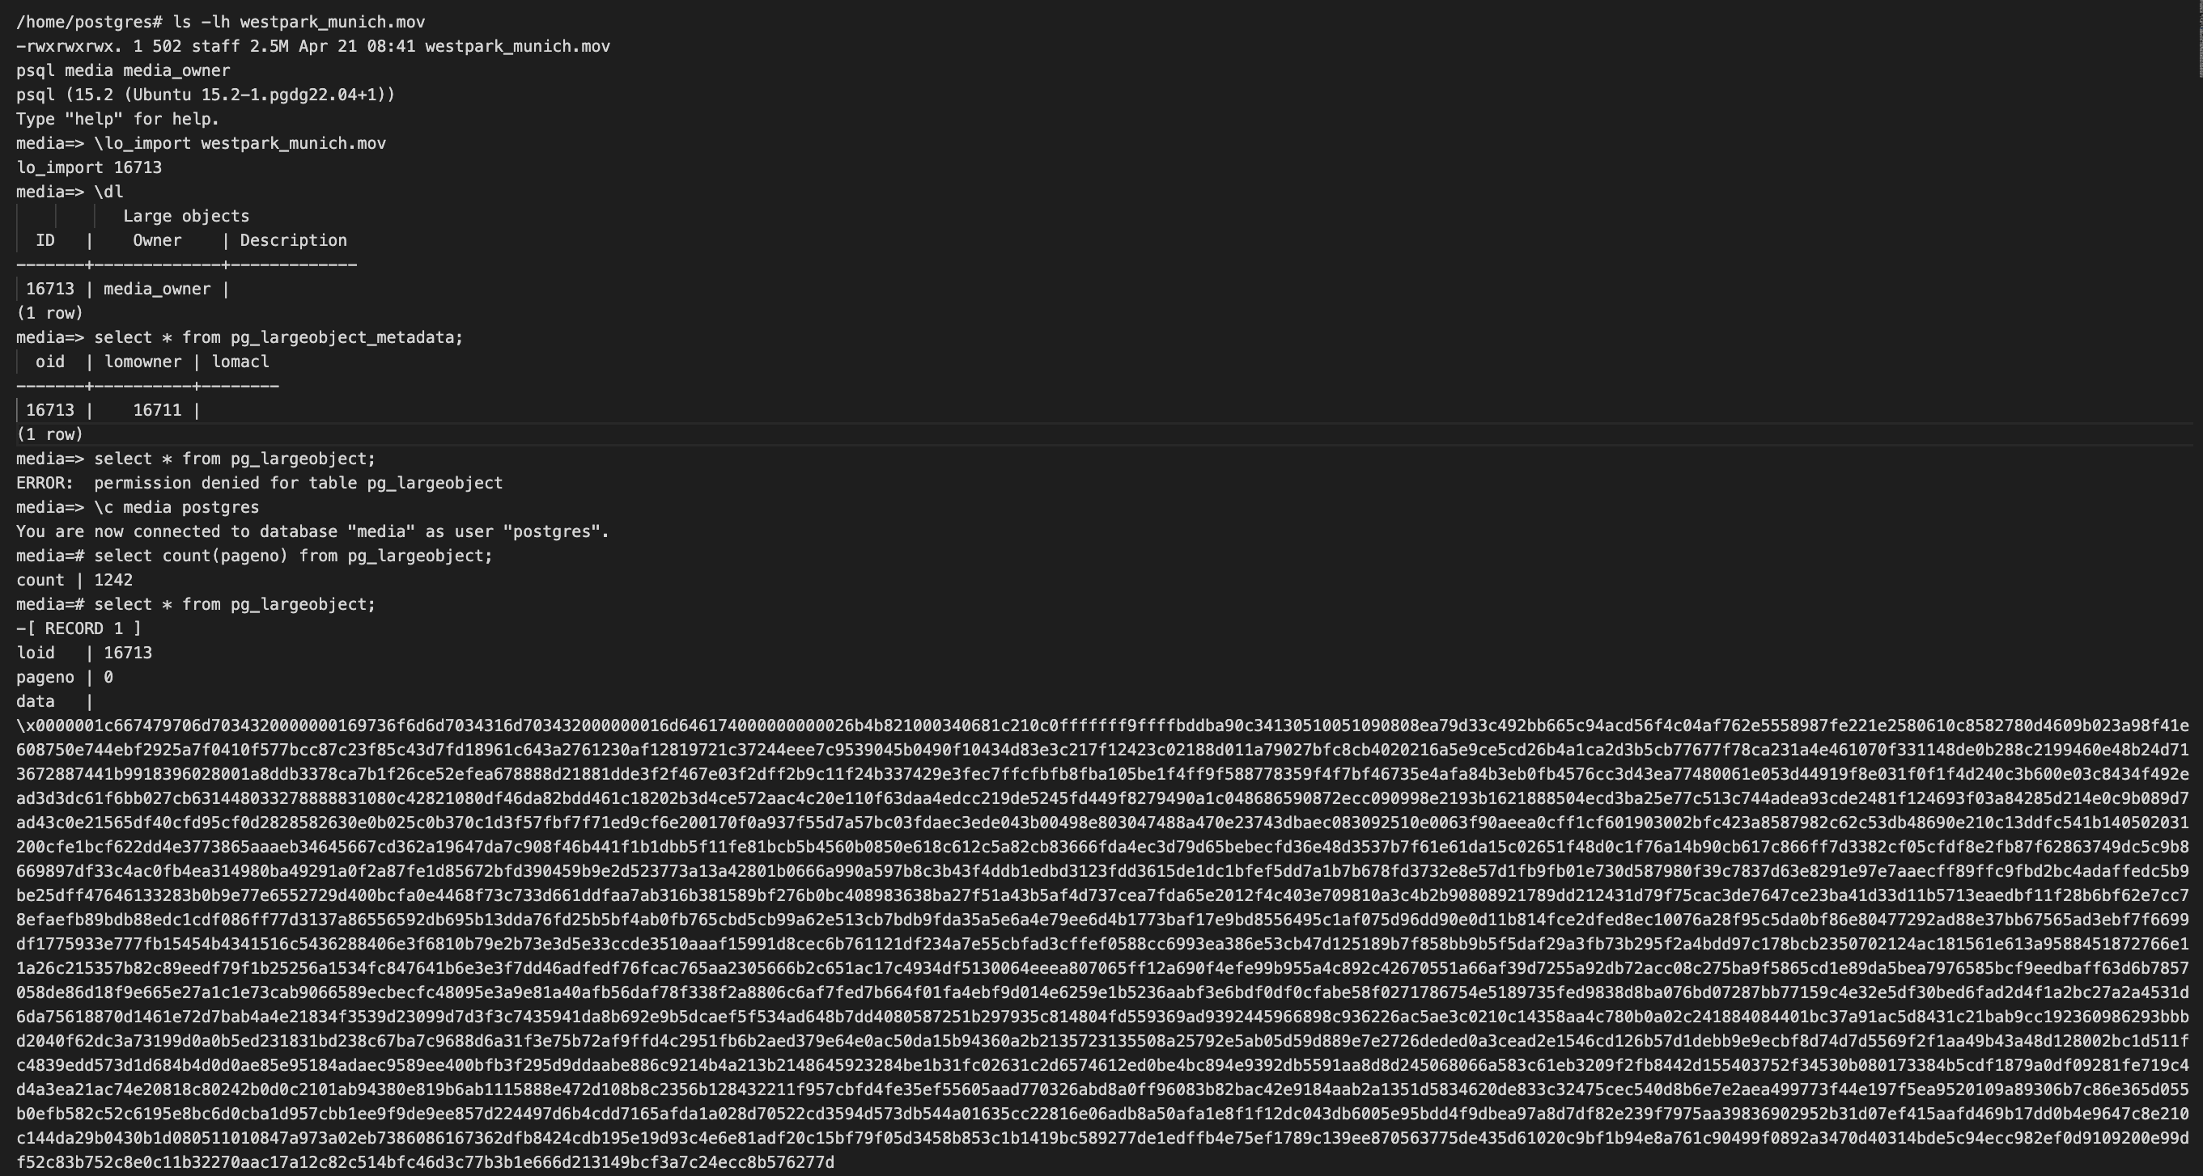
Importing the file as a largeobject in PG

Slide 12
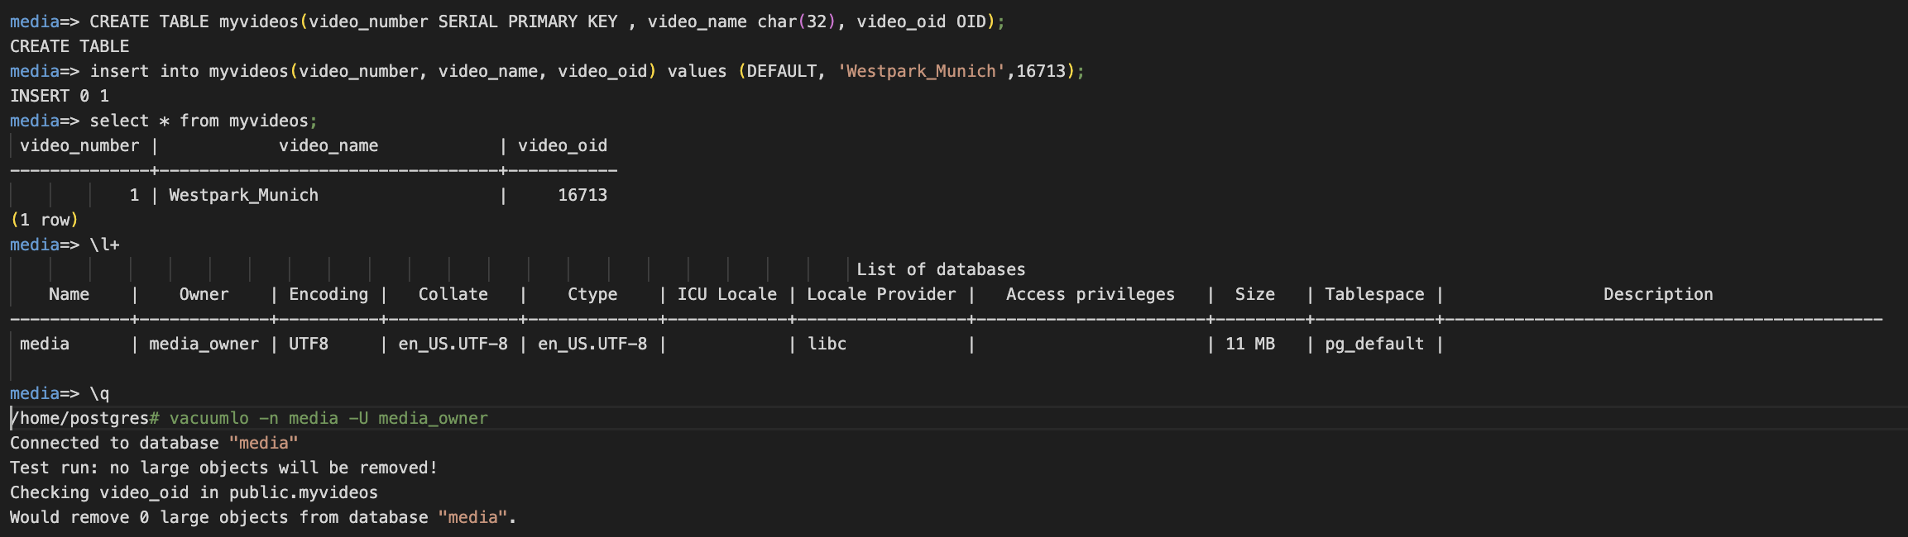
Creating a table and using the oid from above to refer to the largeobject:

Slide 13
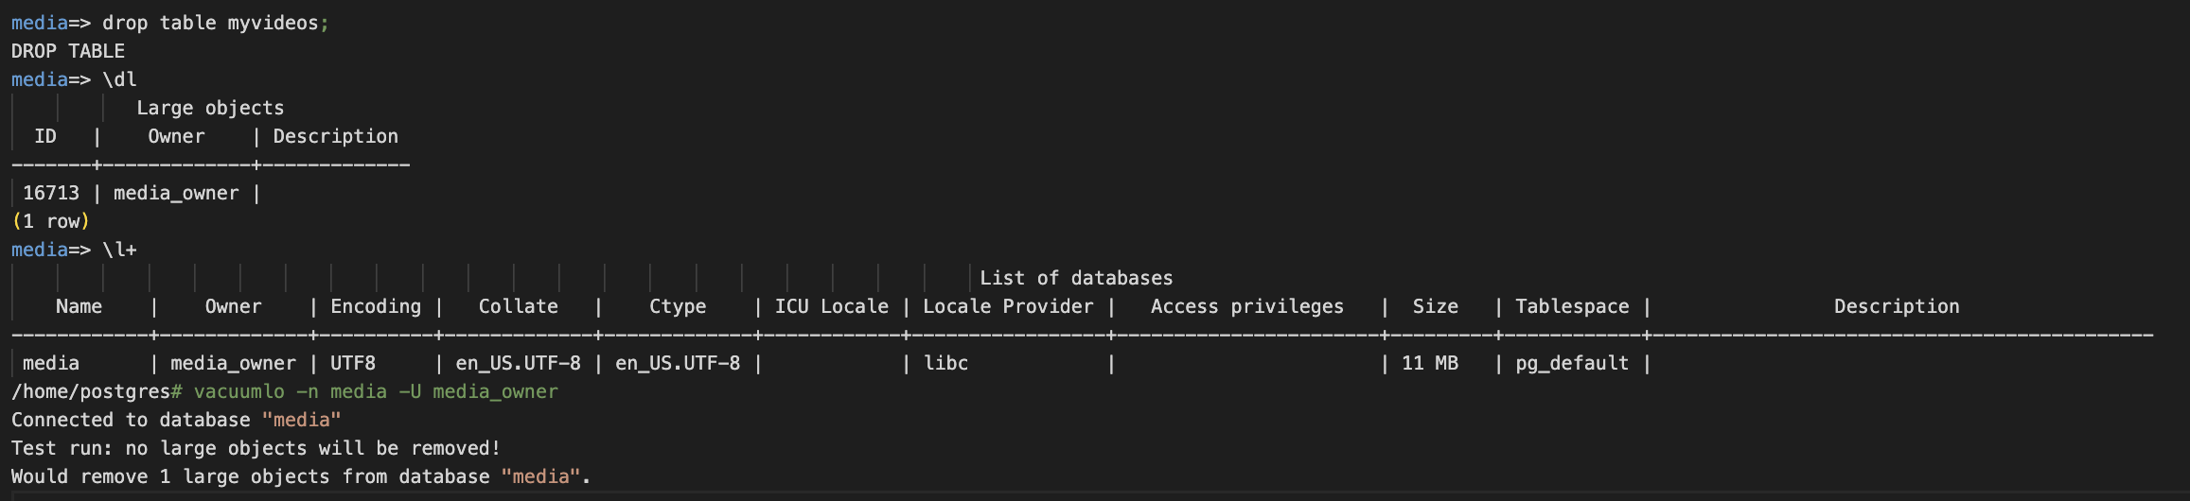
Deleting reference data:

Slide 14
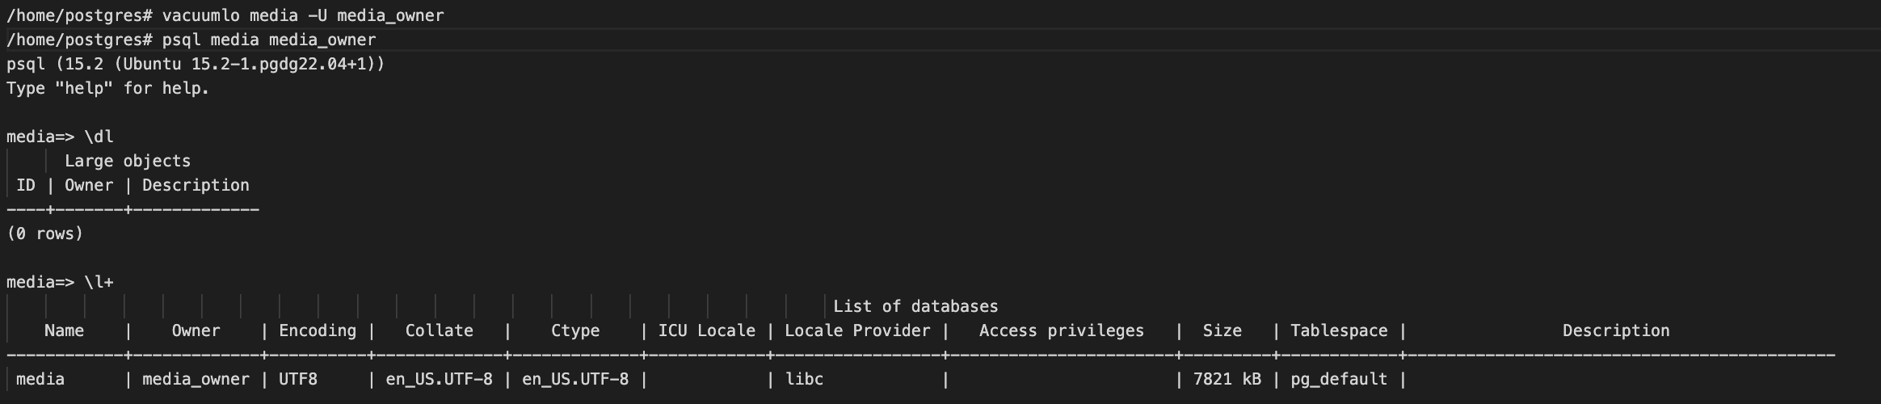
RUN Vacuumlo REGULARLY!!!!

Slide 15
What happens when you run Vacuumlo
Establishes a connection to the database
Create and populate LO temp table(vacuum_l) by quering oid from pg_largeobject_metadata table
Runs analyze on this temp table to generate decent plans
Finds any candidate table with type oid
Any additional entries in vacuum_l are orphans and hence will be deleted

Slide 16
Lo module
A setup to delete the largeobject when the reference object is deleted by including it as a trigger
This includes a data type lo and a trigger lo_manage
This module is considered “trusted”, that is, it can be installed by non-superusers who have CREATE privilege on the current database

Slide 17
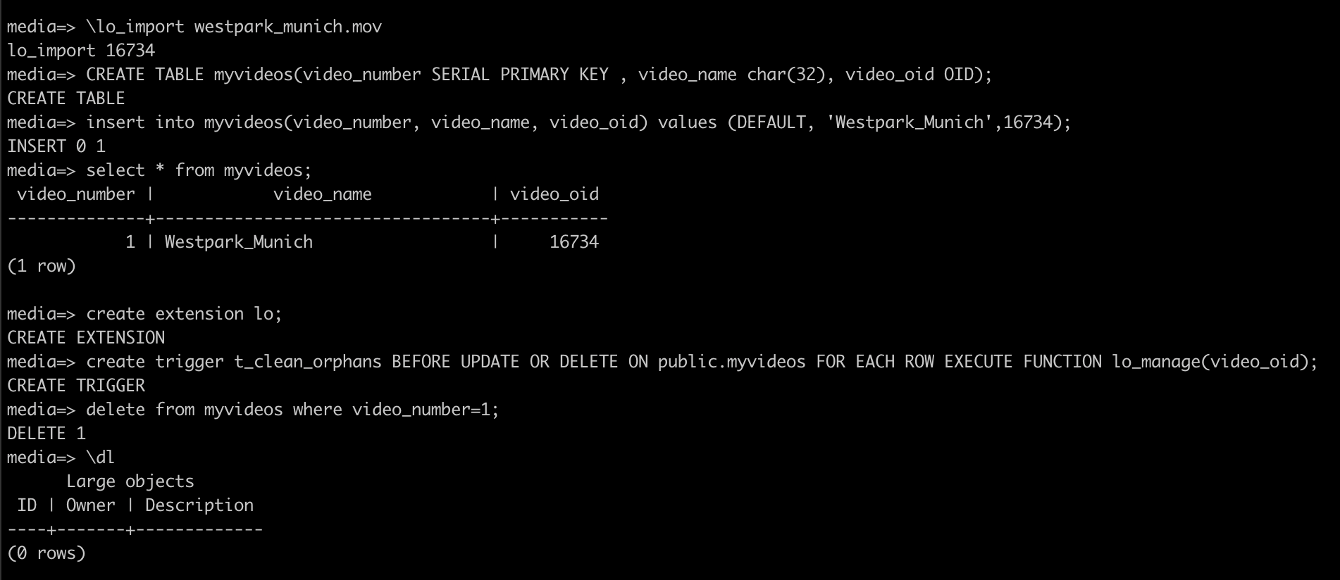

Slide 18
Limitations of LO module
Dropping a table will still orphan any objects it contains
Avoid this by preceding with DELETE FROM table
TRUNCATE has the same hazard
Any orphans existing outside the column mentioned in the trigger or from before can be cleaned up only by vacuumlo

Slide 19
Priyanka Chatterjee

